Slide 1
Stella V
Credit Card Fraud Detection
3/21/2024 Annual Review

Slide 2

PROJECT TITLE
3/21/2024 Annual Review

Slide 3


PROBLEM STATEMENT
3/21/2024 Annual Review
AGENDA
PROJECT OVERVIEW
WHO ARE THE END USERS?
YOUR SOLUTION AND ITS VALUE PROPOSITION
THE WOW IN YOUR SOLUTION
MODELLING
RESULTS

Slide 4

PROBLEM STATEMENT
Credit card fraud poses a significant threat to financial institutions and consumers alike, necessitating the development of robust detection systems. Leveraging machine learning techniques, our objective is to create a highly accurate fraud detection model capable of distinguishing between legitimate and fraudulent transactions while minimizing false positives. Through meticulous data preprocessing, feature engineering, and model selection, we aim to extract meaningful insights from historical transaction data and deploy a scalable solution into production environments. By focusing on key performance metrics such as accuracy, precision, recall, and F1-score, we strive to deliver a reliable system that not only detects fraudulent activities promptly but also adapts to evolving fraud patterns over time. Ultimately, our efforts aim to safeguard financial transactions, bolster trust, and mitigate financial losses in the ever-evolving landscape of digital commerce.
3/21/2024 Annual Review

Slide 5

PROJECT
OVERVIEW
Dataset
The dataset consists of historical credit card transactions, with each record containing various features such as transaction amount, timestamp, merchant information, and anonymized features for privacy reasons. The dataset is typically imbalanced, with a significantly higher number of legitimate transactions compared to fraudulent ones. Proper preprocessing techniques will be employed to handle missing values, outliers, and class imbalance.
Approach:
Data Preprocessing
Conduct exploratory data analysis (EDA) to understand the distribution of features and identify any patterns or anomalies. Handle missing values, outliers, and class imbalance appropriately.
2.Feature Engineering
Extract relevant features from the dataset and potentially create new features to enhance model performance. Techniques such as dimensionality reduction (e.g., PCA) and feature scaling may be employed
3/21/2024 Annual Review

Slide 6
PROJECT
OVERVIEW
3.Model Selection
Experiment with various machine learning algorithms, including logistic regression, decision trees, random forests, support vector machines (SVM), and ensemble methods. Models will be evaluated using appropriate metrics such as accuracy, precision, recall, and F1-score.
4.Model Evaluation and Tuning
Fine-tune the selected models using techniques such as cross-validation and hyperparameter optimization to improve performance further. Models will be validated on separate test data to assess generalization capability.
5.Deployment
Deploy the trained model into a production environment, integrating it into the credit card processing system. Implement monitoring and alerting mechanisms to detect any drift in model performance over time.
3/21/2024 Annual Review

Slide 7

WHO ARE THE END USERS?
Financial Institutions
Banks, credit card companies, and other financial institutions are primary end users of credit card fraud detection systems. They use these systems to protect their customers' accounts and minimize financial losses due to fraudulent transactions.
2.Cardholders
Individual consumers who use credit cards are also end users of fraud detection systems. They benefit from the added security measures implemented by financial institutions to detect and prevent fraudulent transactions, thereby safeguarding their financial assets and personal information.
3/21/2024 Annual Review

Slide 8
WHO ARE THE END USERS?
3.Merchants
Businesses that accept credit card payments are indirectly impacted by credit card fraud. Fraudulent transactions can result in chargebacks and financial losses for merchants. Therefore, merchants may benefit from fraud detection systems that help prevent fraudulent transactions from occurring.
4.Regulatory Authorities
Regulatory agencies and government bodies may also have an interest in credit card fraud detection systems to ensure compliance with financial regulations and protect consumers' interests.
3/21/2024 Annual Review

Slide 9

YOUR SOLUTION AND ITS VALUE PROPOSITION
Smart Detection
Instead of just following strict rules, our system learns from past data to spot weird patterns that might mean fraud. It's like having a super-smart detective watching out for you all the time.
2.Knowing Your Moves
Everyone has their own unique way of doing things online. Our system pays attention to how you type, click, and move your mouse. If something seems off, it raises a flag to protect your account.
3.Instant Watchdog
Imagine having a superhero sidekick watching over your transactions in real-time. If anything fishy happens, it alerts you right away so you can take action before it's too late.
3/21/2024 Annual Review

Slide 10
YOUR SOLUTION AND ITS VALUE PROPOSITION
4.Unraveling the Bad Guys' Network
Fraudsters often work together in sneaky networks. Our system uses fancy tools to map out these connections, helping us see how they're pulling off their scams. This helps us stop them in their tracks.
5.Making Sense of It All
Our system doesn't just work in the background; it also explains why it thinks something might be fraud. This helps you understand what's going on and trust that we're looking out for you.
3/21/2024 Annual Review

Slide 11

THE WOW IN YOUR SOLUTION
Smart Tech to the Rescue:
Our solution is like having a genius detective on the case. It learns from past frauds to spot new ones, without relying on strict rules
.
2.Your Personal Digital Fingerprint:
Just like no two snowflakes are alike, your online behavior is unique. We use this to create a special profile for you. If anything fishy happens, we'll know right away and sound the alarm.
3.Keeping Watch 24/7:
We're always on guard, watching your transactions in real-time. If something seems off, we'll alert you immediately, so you can take action fast.
3/21/2024 Annual Review

Slide 12
THE WOW IN YOUR SOLUTION
4.Unraveling Fraudster Secrets
Fraudsters work together like a team of villains. But we've got the tools to uncover their plans and stop them in their tracks, keeping your money safe from their tricks
.
5.Clear and Trustworthy
We believe in keeping things transparent. Our solution explains why it thinks something might be fishy, so you can trust that we've got your back.
3/21/2024 Annual Review

Slide 13
MODELLING
Teams cam add wireframes
Getting Data
First, we gather a bunch of information about past credit card transactions—things like how much money was spent, where it was spent, and when.
2.Cleaning Data
We tidy up the data, fixing any mistakes or missing pieces, so it's ready to use.
3.Finding Clues
We look at all the transaction details and try to figure out what might indicate fraud. Maybe certain spending patterns or unusual activity could be signs.
4.Choosing a Detective
We pick a smart computer program (like a detective) that's good at spotting fraud. There are different ones to choose from, like Decision Trees or Neural Networks.
n
3/21/2024 A nual Review

Slide 14
MODELLING
Teams cam add wireframes
5.Training the Detective
We teach our computer detective by showing it lots of examples of real transactions—some fraudulent, some not. It learns from these examples so it can spot fraud on its own.
6.Testing the Detective
Once our detective has learned enough, we test it on new transactions it hasn't seen before. We see how well it can spot fraud compared to what we already know to be true.
7.Using the Detective
If our detective does a good job, we can start using it to check new credit card transactions in real-time. It will flag any transactions that seem suspicious so we can investigate further.
n
3/21/2024 A nual Review

Slide 15
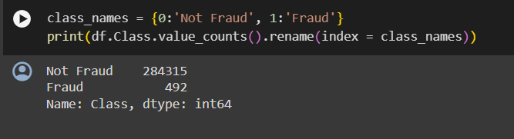
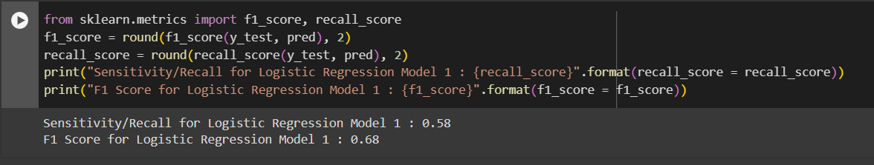
RESULTS
Demo Link
n
3/21/2024 A nual Review

